Slide 1
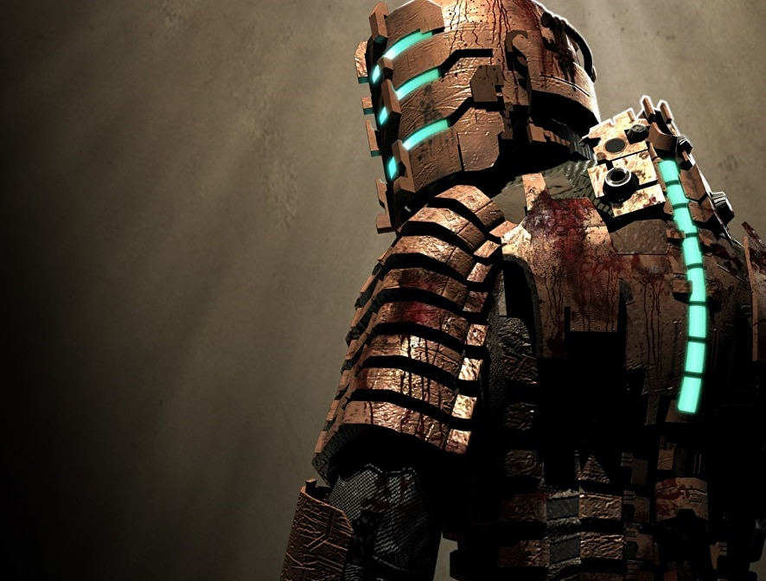
From Resident Evil 2 to Dead Space
The Evolution of
Survival Horror
IT608 Game Development 1
Kauê Reis de Assis Pereira
Dead Space
2008

Slide 2
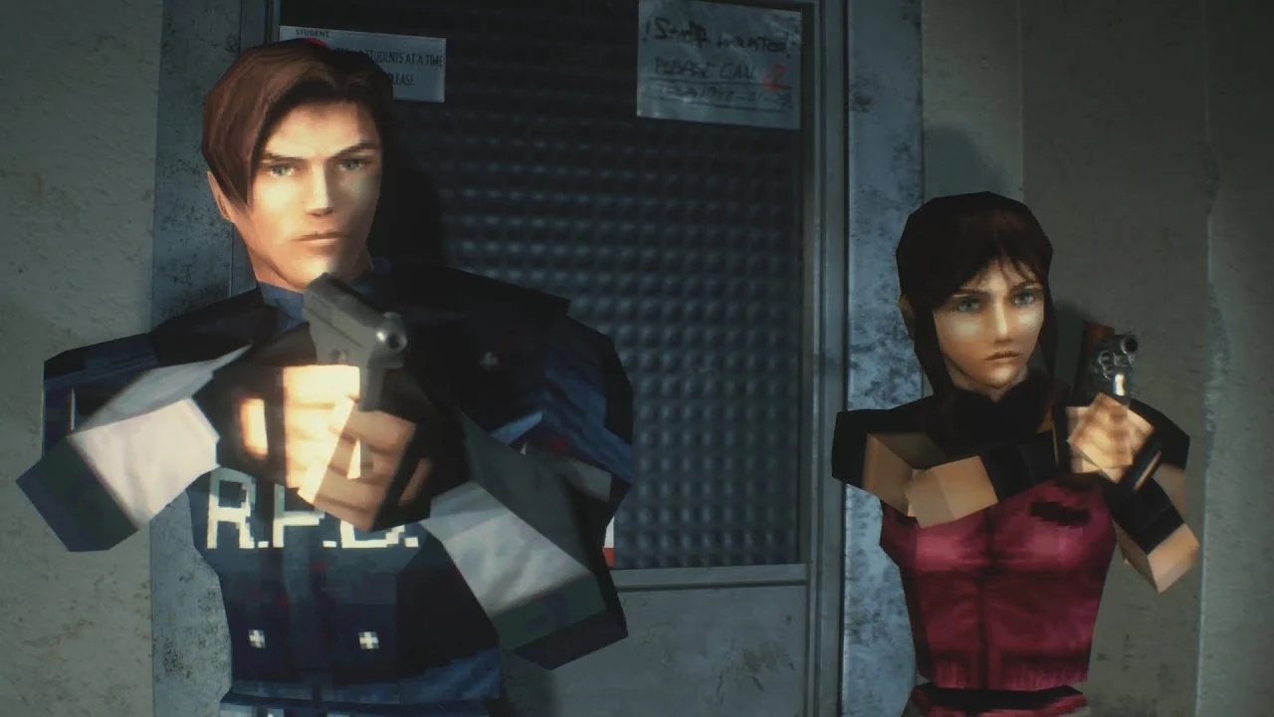
Contents
Origins of the genre
What is survival horror
Resident Evil 2 vs Dead Space
History
Hardware limitations
Sound design
Gameplay and mechanics
Conclusion
Questions
References
Resident Evil 2
1998

Slide 3
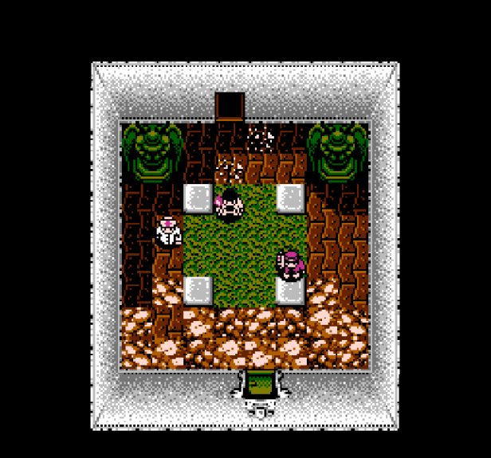
Sweet Home
By Capcom, 1989
Based on homonymous film
Released only in Japan
Considered the first survival horror
Sweet Home
1989

Slide 4
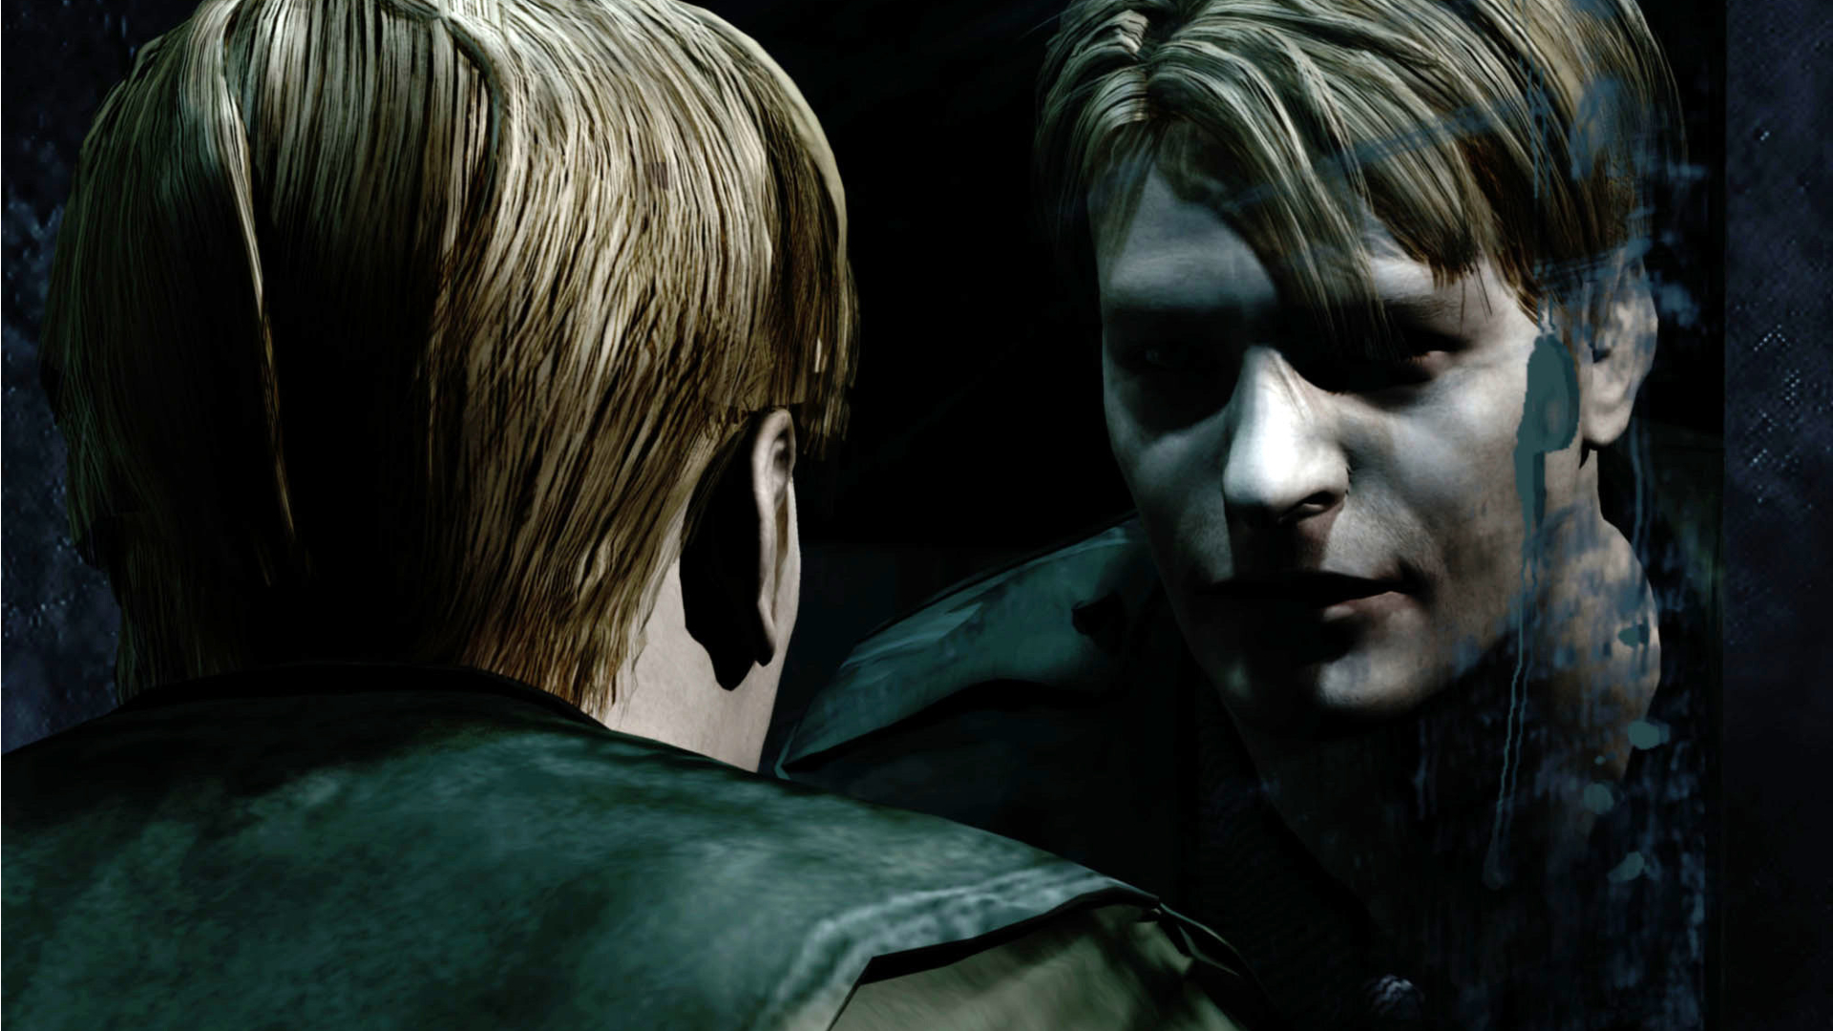
Survival Horror
Subgenre of action-adventure and horror
Leads players to feel weak and vulnerable
Popularized by Resident Evil in late 90s
Silent Hill 2
2001

Slide 5
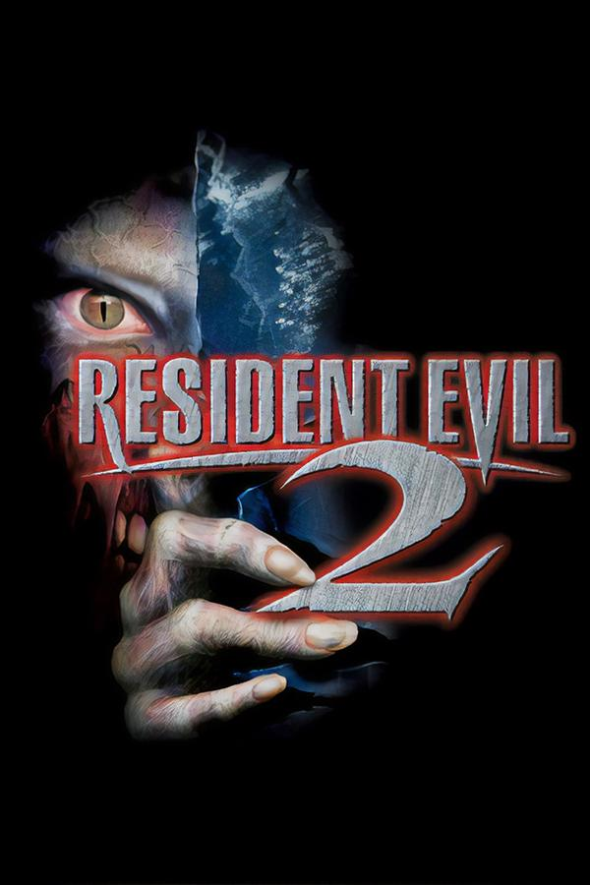
History
Resident Evil 2
By Capcom, 1998
Two playable characters, Leon and Claire
Brought zombies back to the pop culture
More than 5 million copies sold in first year
Remake in 2019
Resident Evil 2
1998

Slide 6
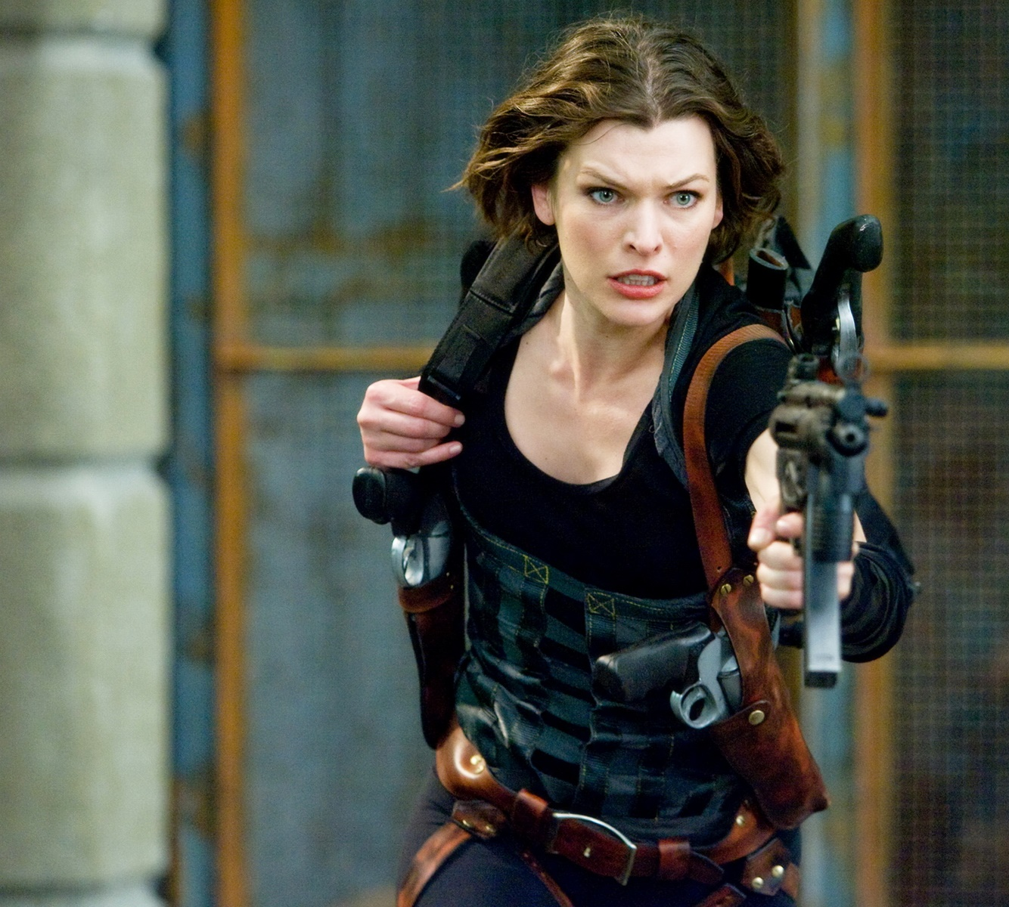
History
Resident Evil
More than 30 games
142 million units sold
Films
TV series
Comic books
Action figures
Amusement park attraction
Resident Evil: The Final Chapter
2017

Slide 7
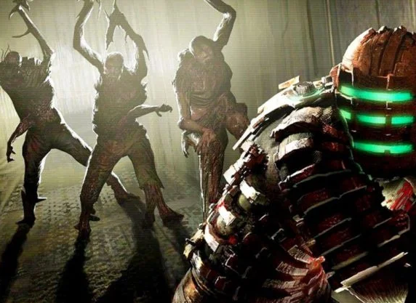
Dead Space
History
By EA Redwood Shores, 2008
Heavily influenced by Resident Evil 4
Set on 2508, on the Ishimura mining spaceship
Follows engineer Isaac Clarke as he tries to fix the Ishimura
Dead Space
2008

Slide 8
Dead Space
History
8 games
2 sequels
4 spin-offs
1 remake
Comic books
Novels
Animated Films
Dead Space
2008

Slide 9
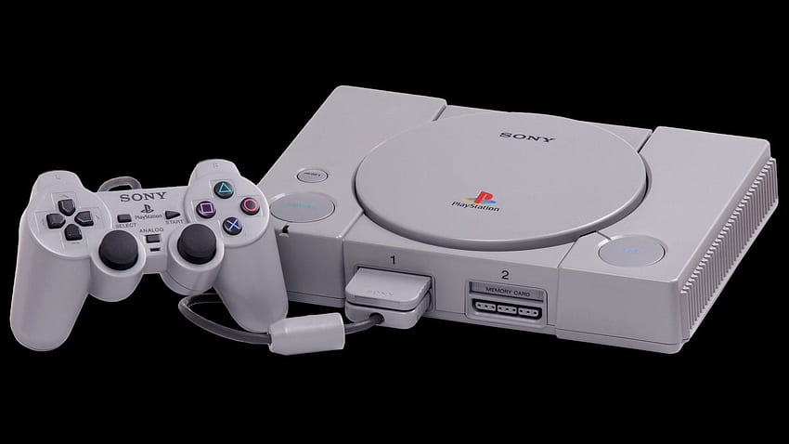
Hardware Limitations
32-bit CPU
2MB RAM
1MB VRAM
Sony PlayStation
1994

Slide 10
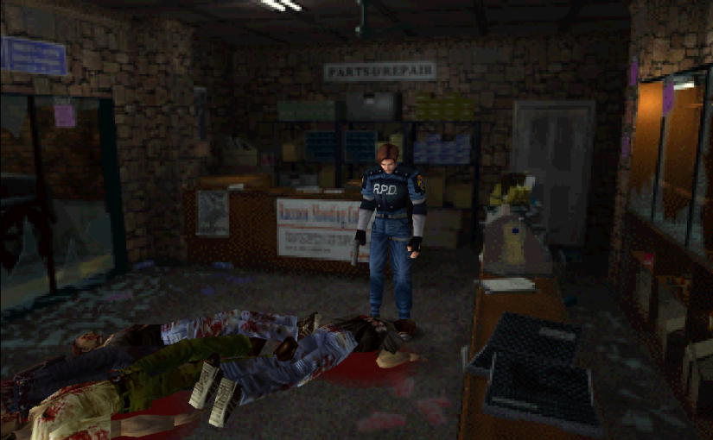
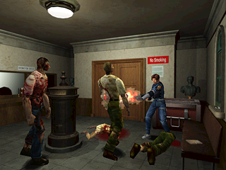
Hardware Limitations
Fixed camera angles
Pre-rendered backgrounds
Characters were fully built on 3D polygons
Resident Evil 2
1998

Slide 11
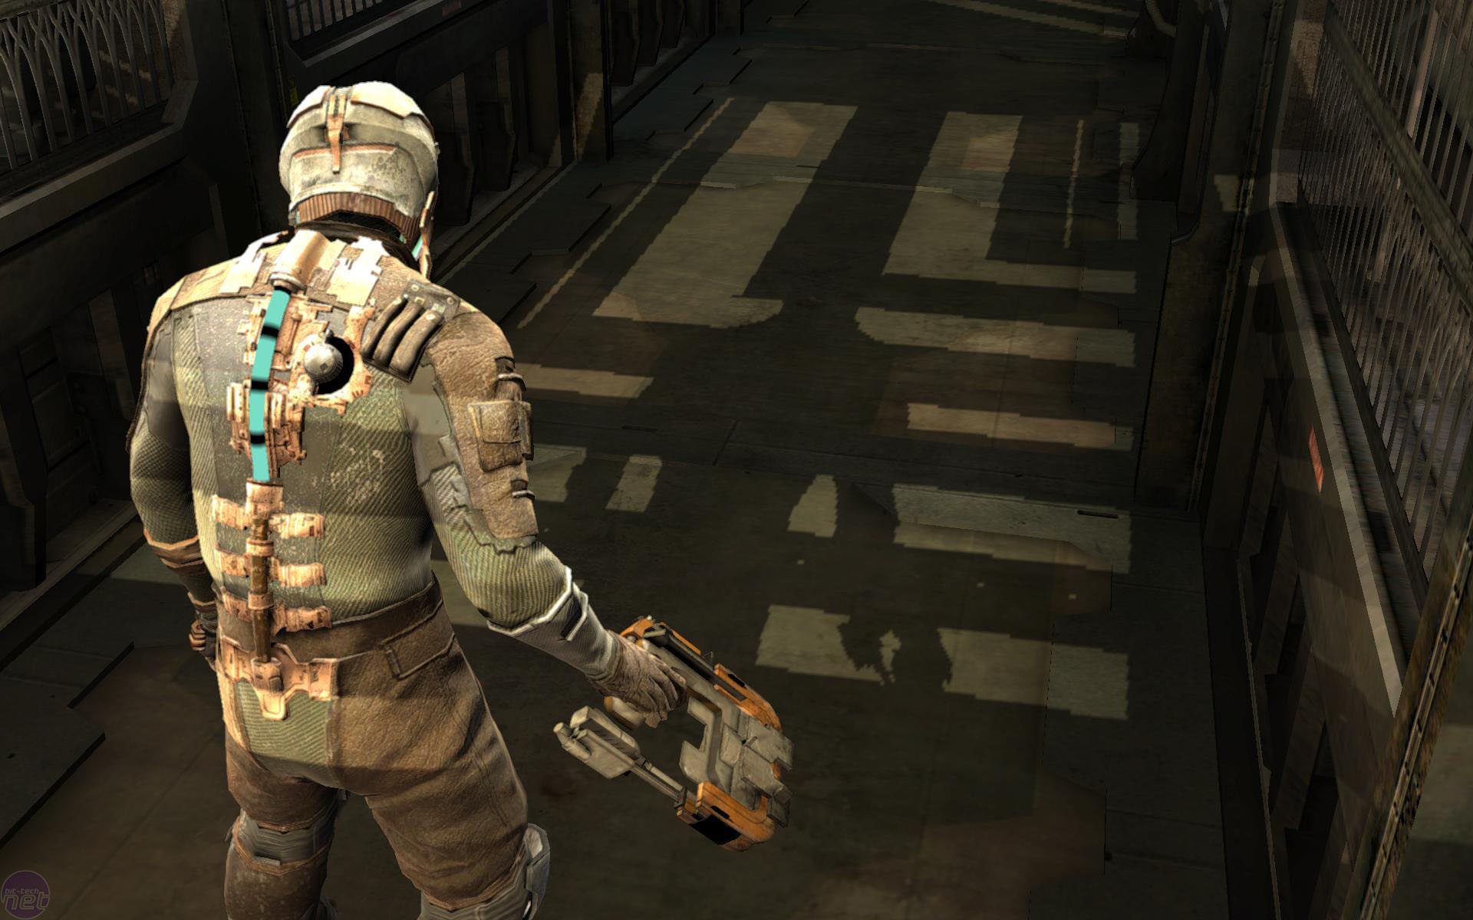
Hardware Limitations
High quality graphics
3D real time rendered environment
Variety of guns
Variety of enemies
More intelligent AI
Advanced game mechanics
Dead Space
2008

Slide 12
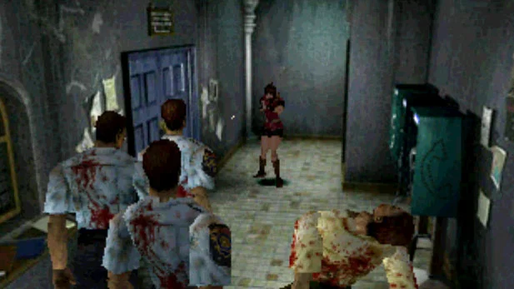
Sound Design
Resident Evil 2
Recycled sound effects
Fixed camera angle influence on sound design
Audio cues complement lack of visibility
Poor voice acting
Resident Evil 2
1998

Slide 13
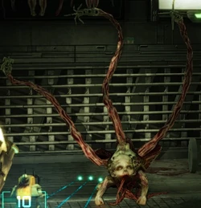
Sound Design
Dead Space
Original sound effects
3D sound ambience
Randomly modified ambient tracks
Audio cues
Each Necromorphs has its own sound
Bigger threats have more distinct sound
Enhanced environment sounds
Ishimura
Zero oxygen environments
Dead Space
2008

Slide 14
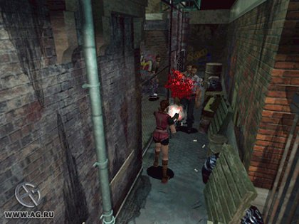
Gameplay and Mechanics
Resident Evil 2
Limited visibility
Tank controls
Resource management
No walking and shooting
Collectibles
Puzzle solving
Storytelling
Resident Evil 2
1998

Slide 15
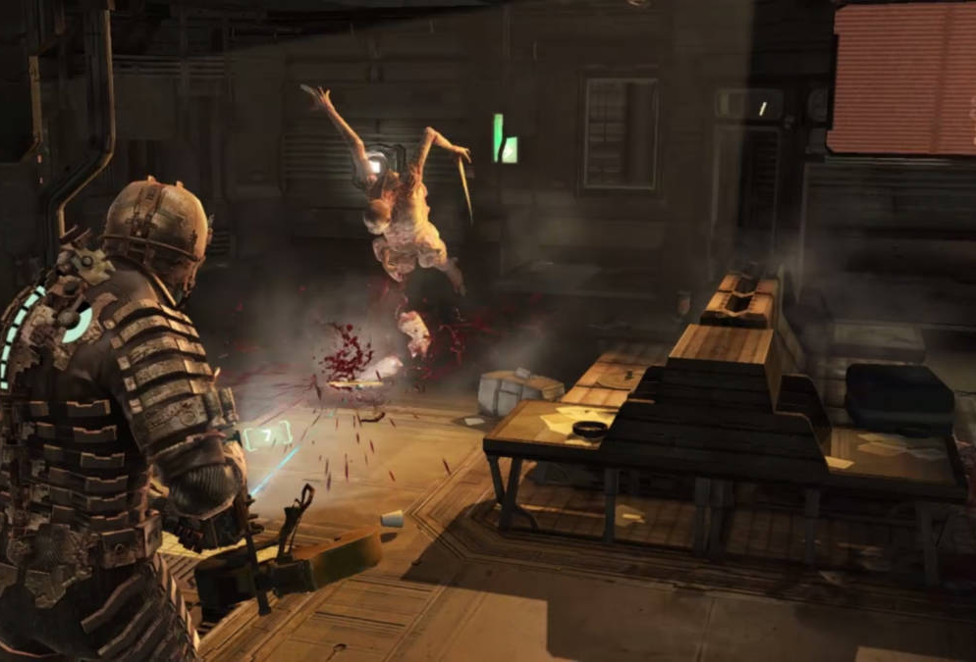
Gameplay and Mechanics
Dismemberment system
Necromorphs
Variety and adaptability
Behavior
Ambush
Play dead
Flank
Team up strategically
Gun mechanics
Integrated HUD
Resource management
Action
Zero gravity and zero oxygen environments
Dead Space
2008

Slide 16
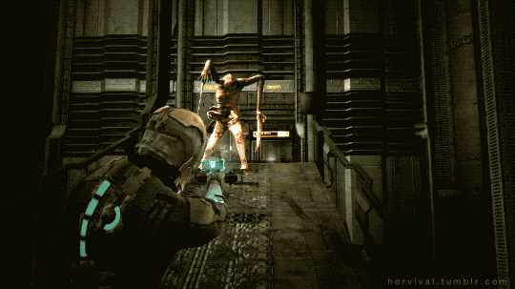
Dismemberment system
Gameplay and Mechanics
Dead Space
2008

Slide 17
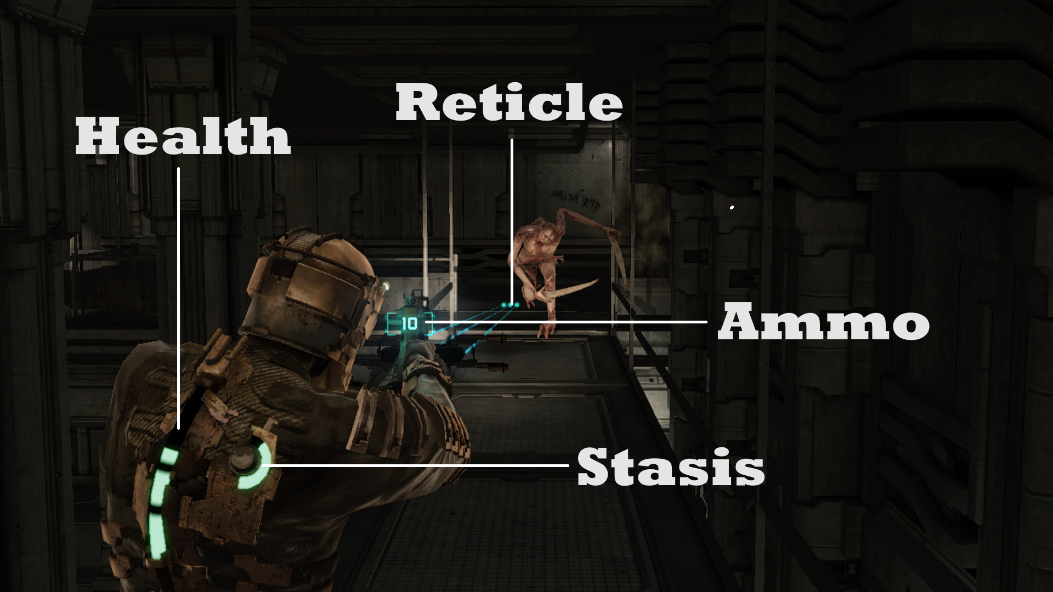
HUD
Gameplay and Mechanics
Dead Space
2008

Slide 18
Conclusion

Slide 19
Questions?

Slide 20
References
WhatIfGaming. (2022, October 14). Dead Space Remake [Digital image]. In S. Hasan (Ed.) https://whatifgaming.com/dead-space-remake-to-bring-new-features-including-improved-exploration-and-no-loading-sequences/
Retro Gamer Team. (2012, June 7). Sweet Home - Retro Gamer [Digital image]. https://www.retrogamer.net/wp-content/uploads/2012/06/new-sweet-home-616x575.png
Eurogamer. (2022, October 24). Silent Hill 2 [Digital image]. In E. Nightingale (Ed.) https://www.gamesradar.com/silent-hill-2-part-1/
IMDb. (n.d.). View 'Resident Evil 2' poster [Digital image]. https://www.imdb.com/title/tt0161941/
Kelly, A. (2021, November 19). Dead Space [Digital image]. https://www.thegamer.com/dead-space-sci-fi-horror-masterpiece/
Pxfuel. (2021, November 19). PS1, PlayStation 1 HD wallpaper [Digital image]. https://www.pxfuel.com/en/desktop-wallpaper-jmeoc
londoncitynights. (2019, October 6). Resident Evil 2 (PlayStation, 1998) - Pixel Hunted [Digital image]. Pixel Hunted. https://pixelhunted.wordpress.com/2019/10/06/beaten-resident-evil-2-playstation-1998/
Lopes, J. P. S. (2012, April 24). Resident Evil 2 [Digital image]. Melhor Final. http://melhorfinal.blogspot.com/2011/03/resident-evil-2-retro-analise.html
Martin, J. (2008, October 21). Dead Space Dead Space - Graphics II [Digital image]. https://bit-tech.net/reviews/gaming/pc/dead-space/4/
alisonsutcliffe. (n.d.). Dead Space - Dismemberment [Digital image]. http://rom.happyvalentinesday2020.online/dead-space-twitcher-gif-8b0b.html
gamer_152. (2020, October 11). Dead Space [Digital image]. Giant Bomb. https://www.giantbomb.com/profile/gamer_152/blog/markers-i-a-deep-dive-into-dead-spaces-ui/249377/
Krieger, J. (2017, December 8). Memorable Mechanics: Dead Space's Dismemberment System [Digital image]. Cultured Vultures. https://culturedvultures.com/memorable-mechanics-dead-spaces-dismemberment-system/

